Slide 1
NPS Facilities Fire Risk Assessment
Group#40
- Abhilash Rajaram
- Krishna Chaitanya
- Sreya Dhar
- Sumit Bawri

Slide 2
Introduction & Motivation
The Fire Risk Assessment project is developed by the National Park Service's (NPS) Fire and Aviation Management program to respond to the devastating 2011 wildfire season and holds data from 1970-2020.
The dataset can be found at https://data-nifc.opendata.arcgis.com/datasets/facility .
The aim of the project is to build a predictive model that evaluates certain contributing factors such as access to the facility, the surrounding environments, construction design and materials and resources available to protect facilities from wildland fire.
The project was developed as an assessment method that could be applied to NPS units nationwide regardless of variations in climate, fuels, and topography.

Slide 3
Real Data
The data collected during the assessment process is used to:
Create a complete inventory with respect to each facility within NPS unit boundaries.
Characterize the facility’s risk of ignition during a wildland fire.
Develop incident response plans for facilities and communities within NPS units.
Identify, plan, prioritize and track fuels treatments at unit, regional and national levels.

Slide 4
Structure Data
The dataset has 64 attributes and 44397 records.
The dataset was divided into the following tables:
Facility - Would have details about the facility IDs
Facility Info – Provides information about particular facility
Facility Location - Provides Information about Facility Location
Community - If the facility resides in a community. Details about community
Access - Mode of transport to reach the facility along with the condition of surroundings
Environment - Details of park area within 300 feet from the facility.
Structure - Details about the construction design and materials of the facility.
Protection – Provides information about the resources available to protect facilities.
The details of each attribute can be found here https://docs.google.com/document/d/1HqPXy4C_wirrV55egJe_MdP5uaGrfg9Yb7RbMUaReMc/edit?usp=sharing

Slide 5
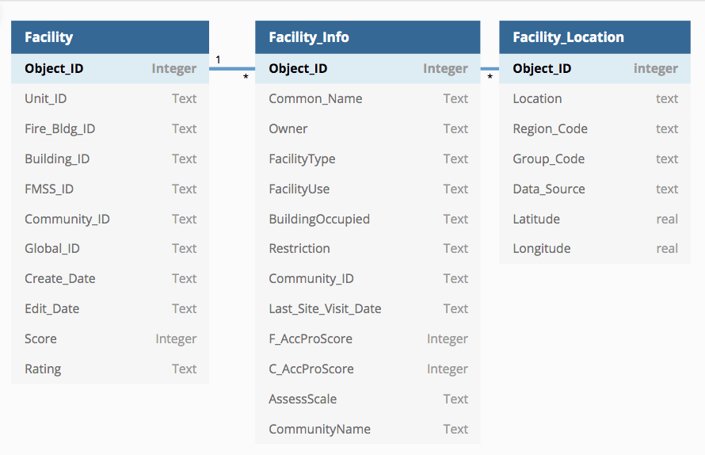
Normalizing Data
Dividing the dataset into 9 different tables in sql

Slide 6
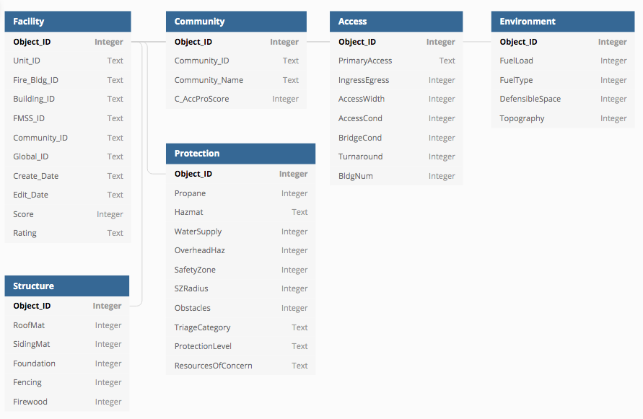

Slide 7
Proposed Analysis
Performing EDA
Data Cleaning
Suitable Data Imputation
Dividing the data into train and test sets
Feature importance analysis
ML algorithms
Summary

Slide 8
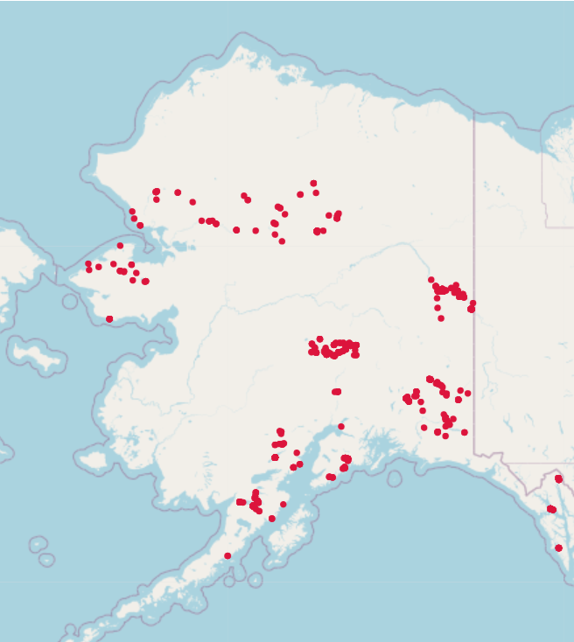
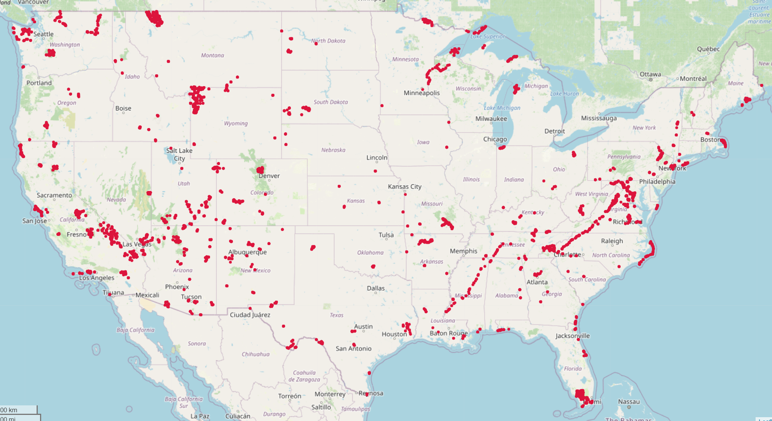

Geographic Location of Different Park Facilities in the Dataset
from folium library

Slide 9
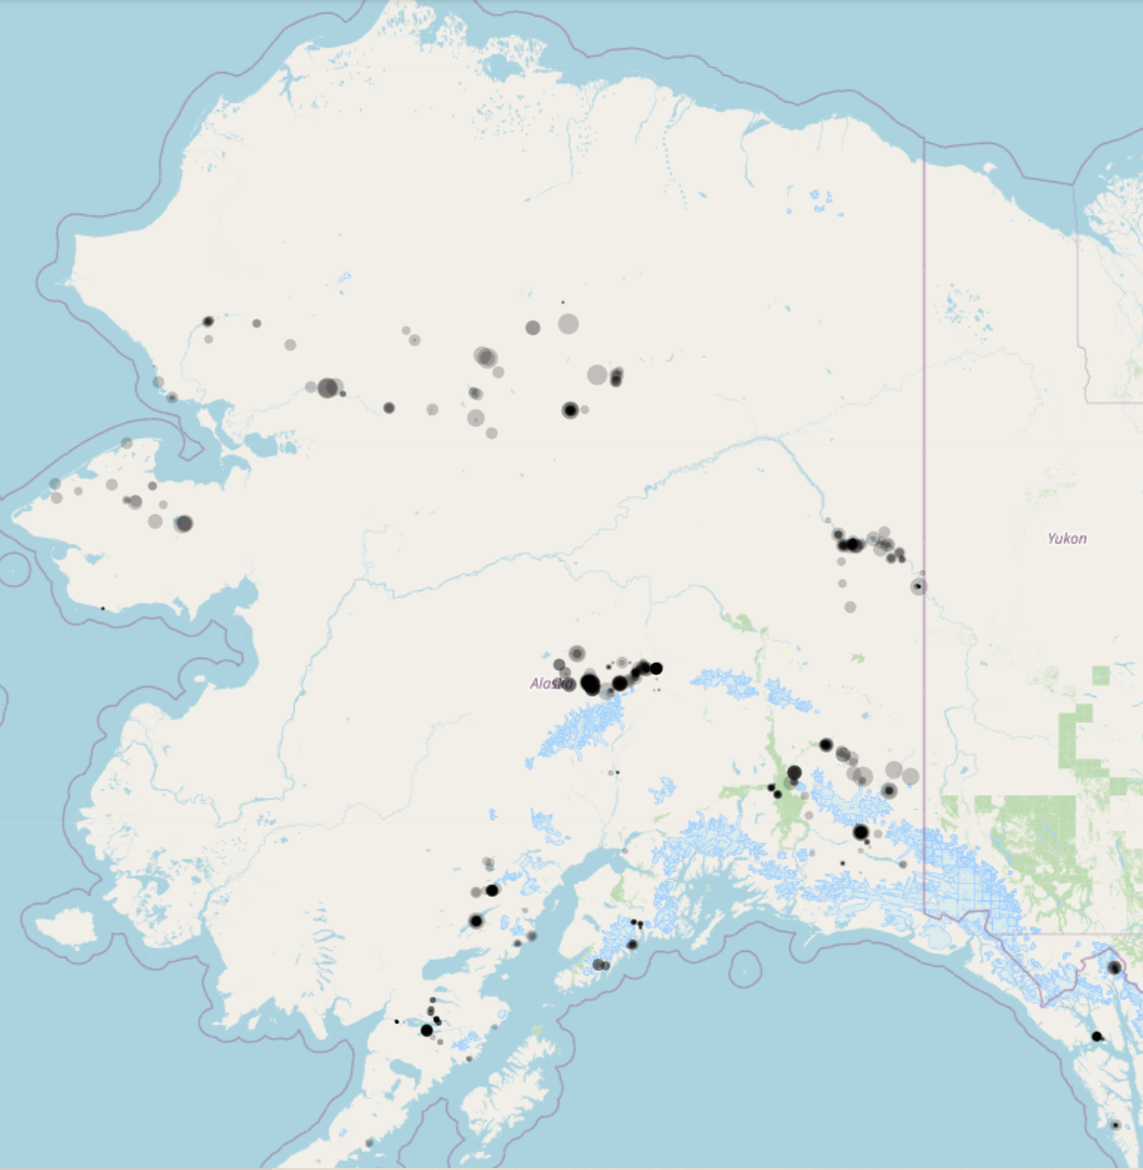
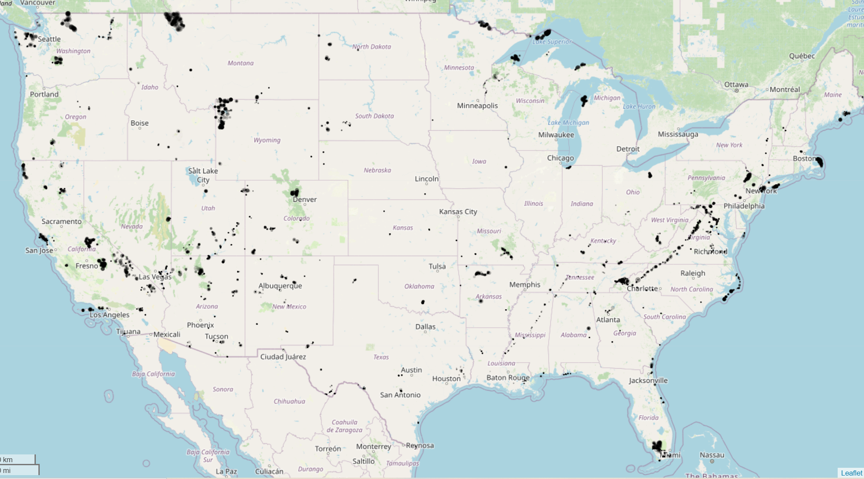
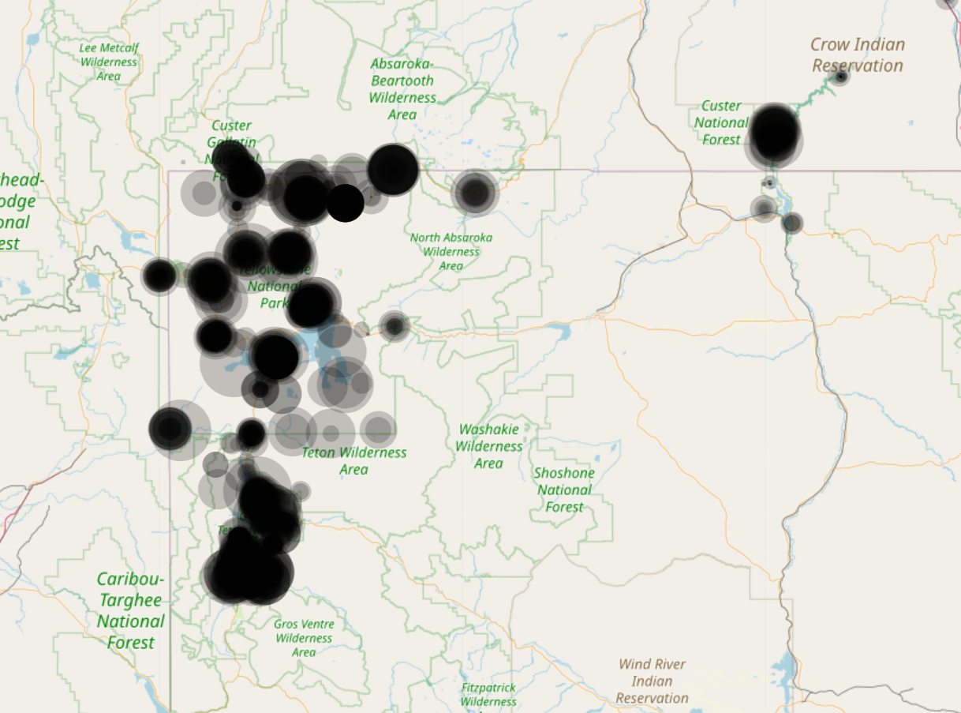

Score Intensity of Park Facilities (lower score is better)
from folium library

Slide 10
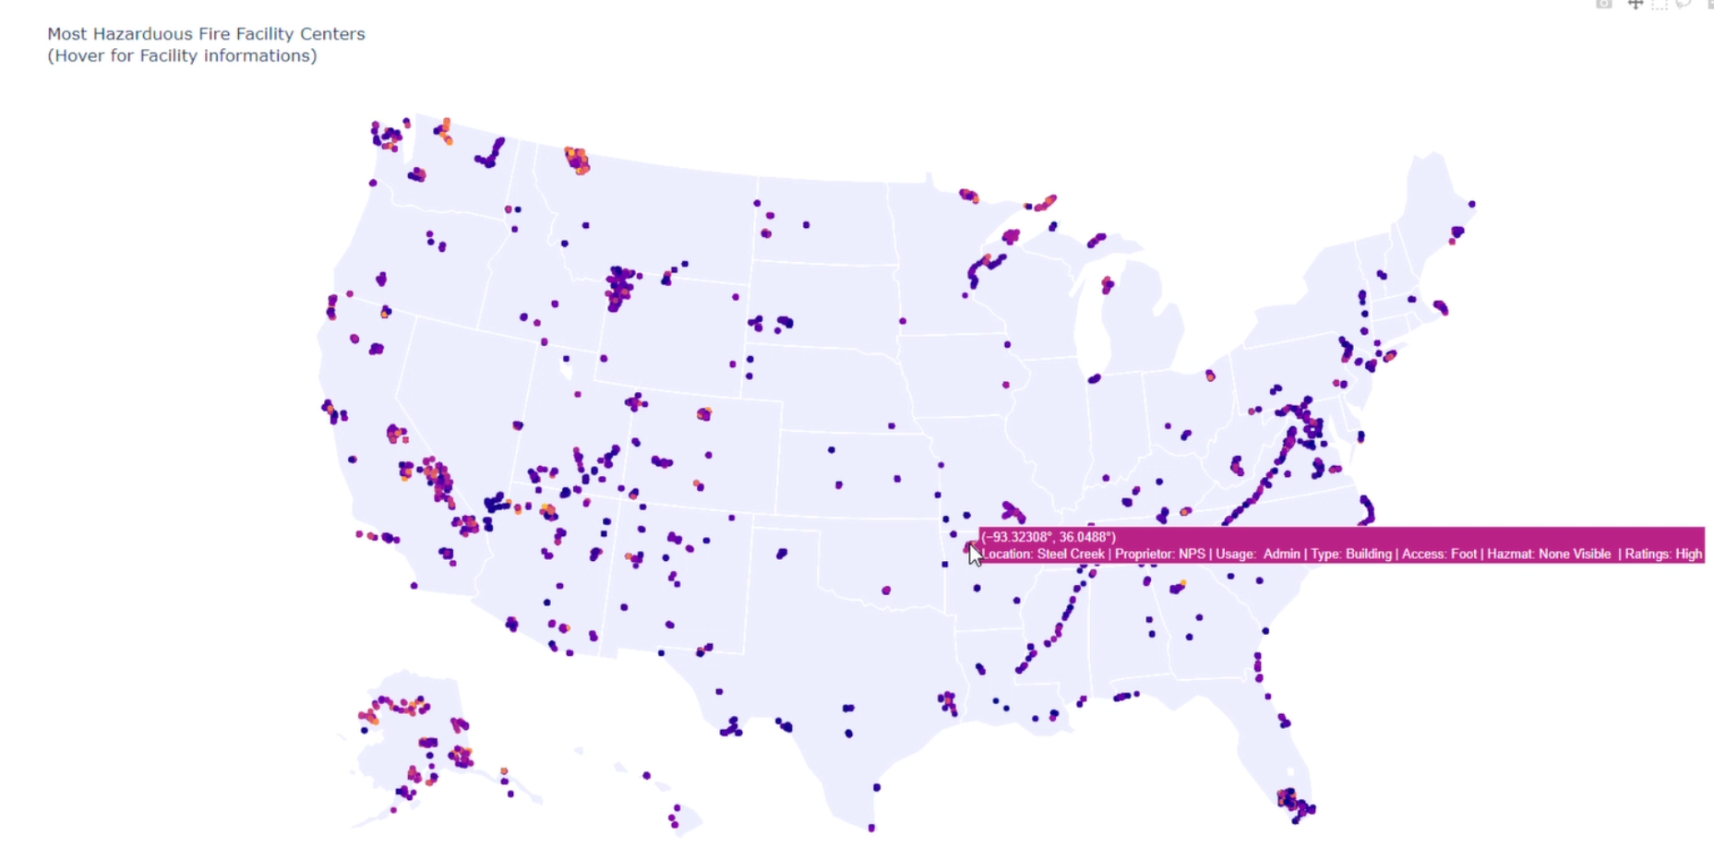
Facility Hazards Information of Different Park Facilities in the Dataset
from plotly library

Slide 11
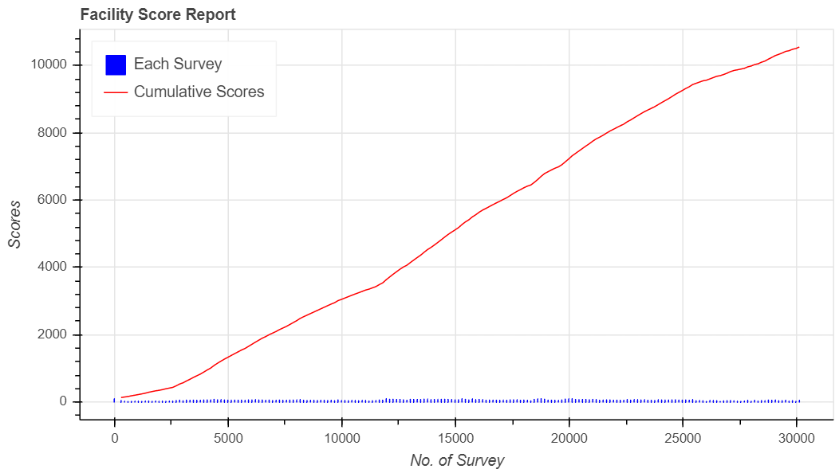
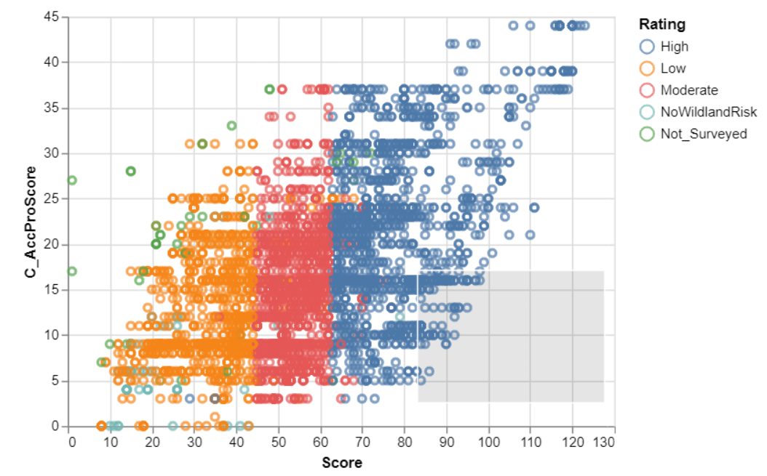
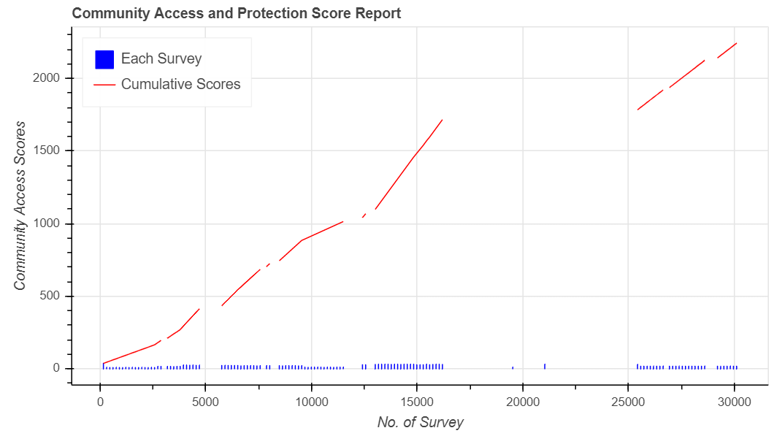
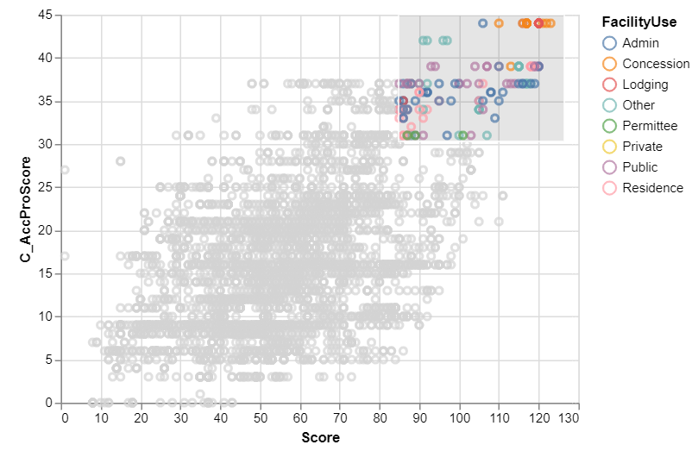
Some interactive visualization
from bokeh library
from altair library
All surveys are not part of communities

Slide 12
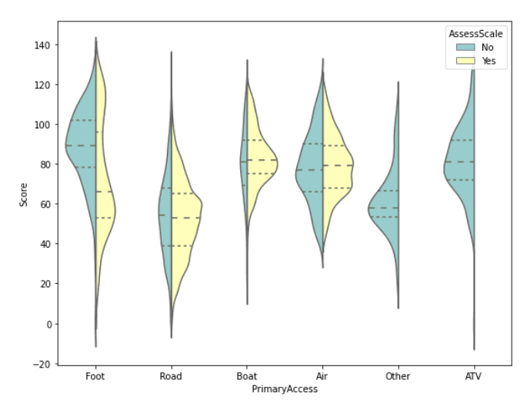
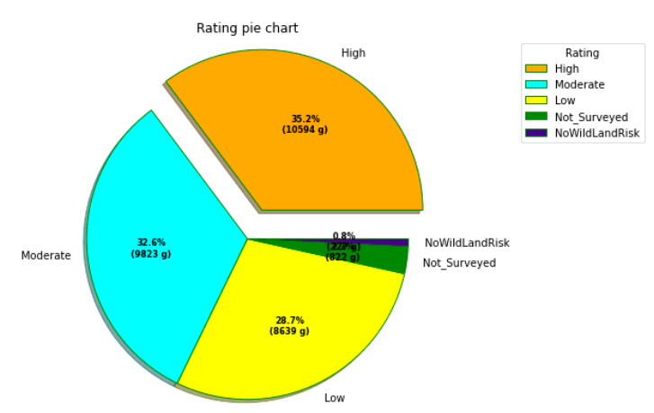
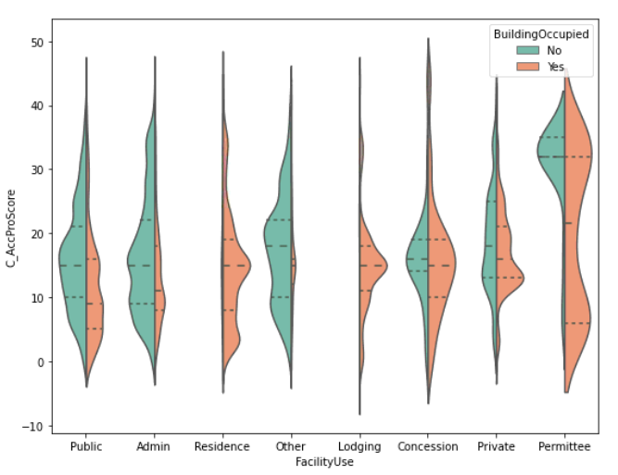
EDA and Visualization
Class variable is unbalanced!
from matplotlib, seaborn, plotly library

Slide 13
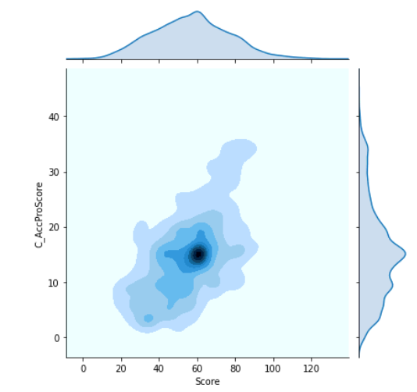
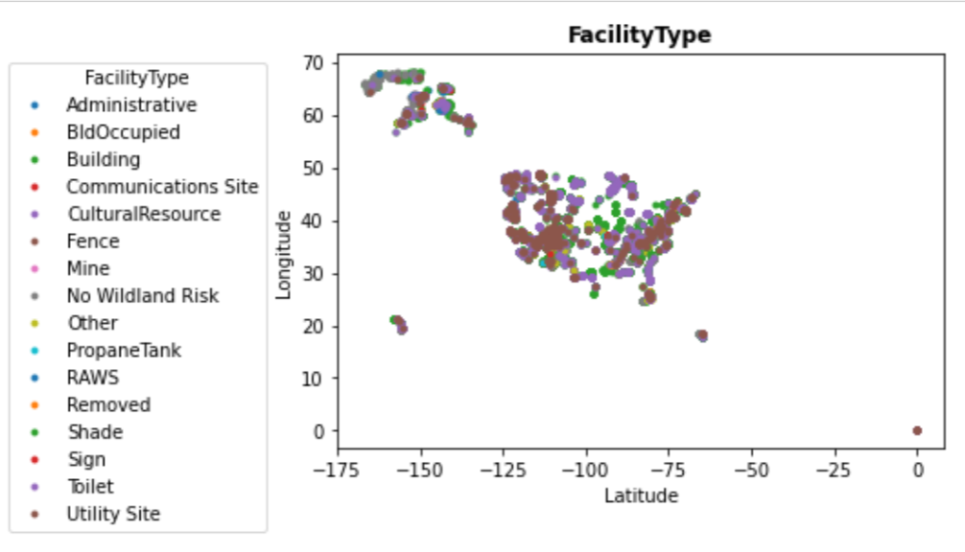
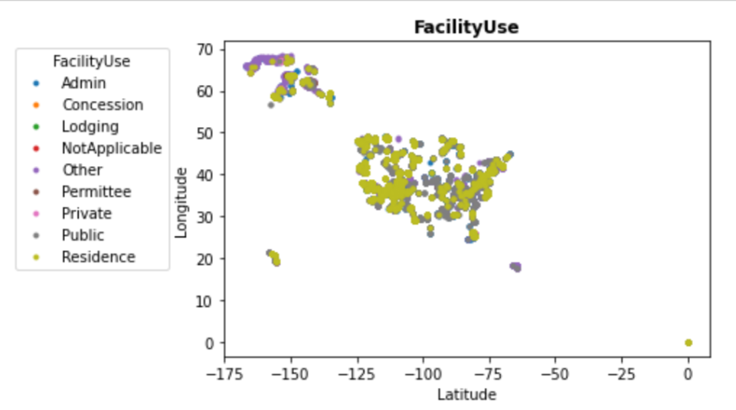
EDA and Visualization
from matplotlib, seaborn library

Slide 14
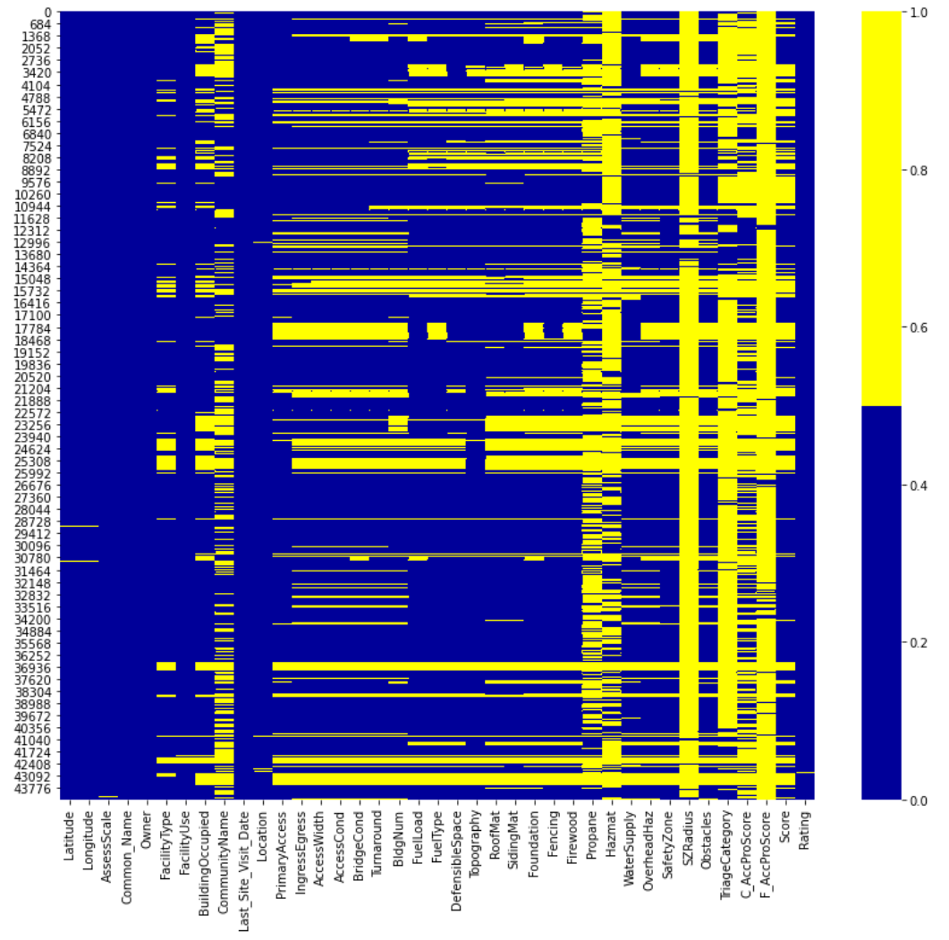
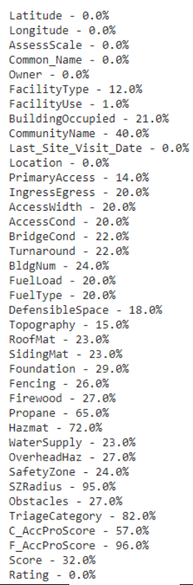
Missing Data Heatmap
% of Missing Values for Each Variable
Data Imputation
Categorical Variables : Most frequent
Numerical Variables : Median

Slide 15
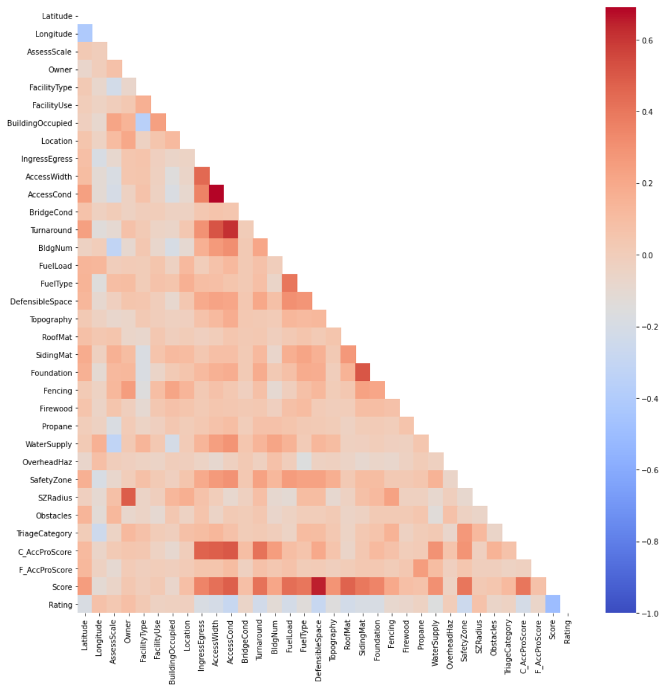
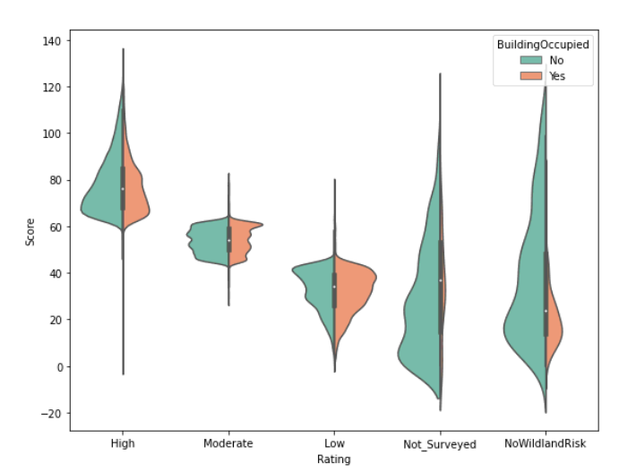
Correlation between different variables
After preprocessing the data, it contains (44397, 34) observations
‘Rating’ is the response variable
# predictor variable is 32!

Slide 16
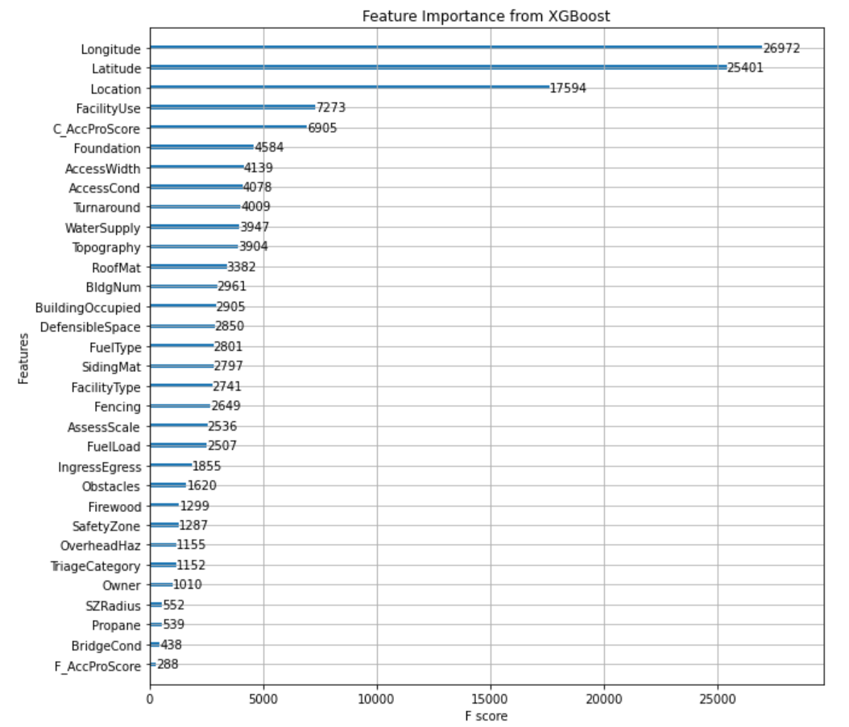
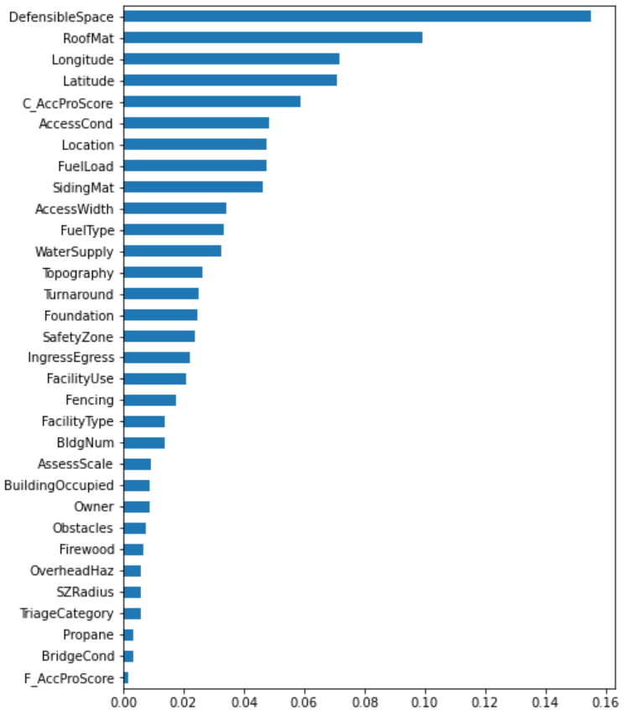
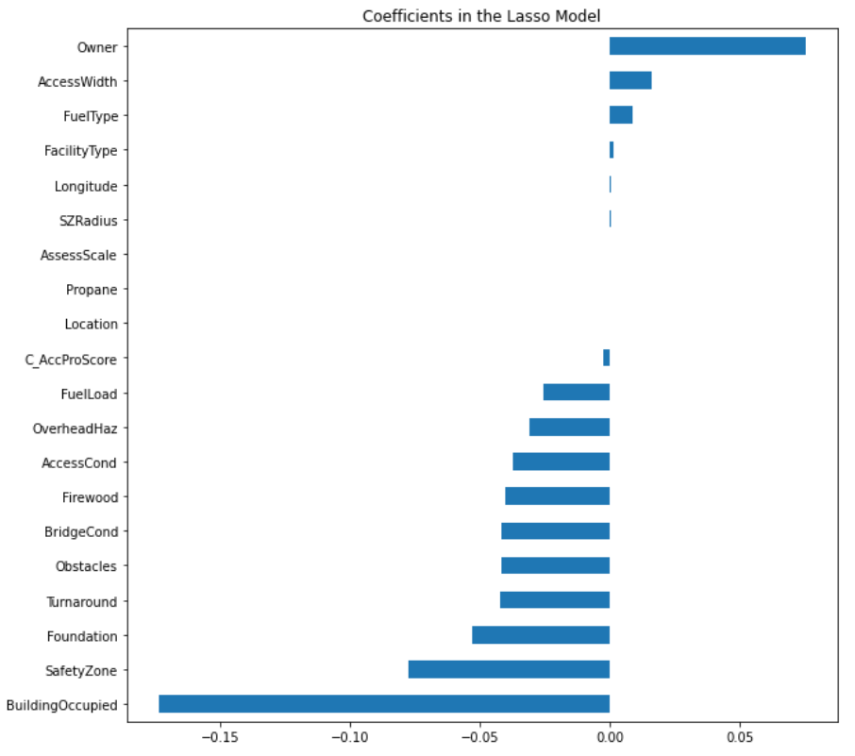
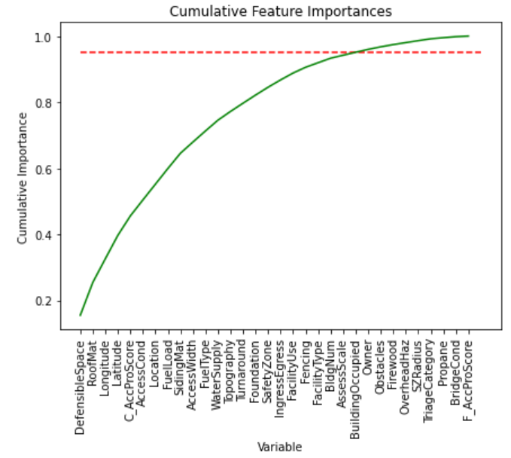
Variable Importance Coefficients
Random Forest
Lasso regression
XGBoost
95%

Slide 17
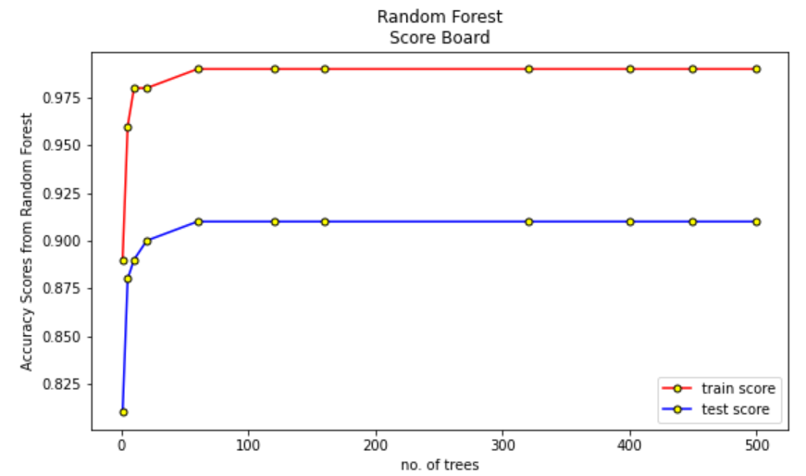
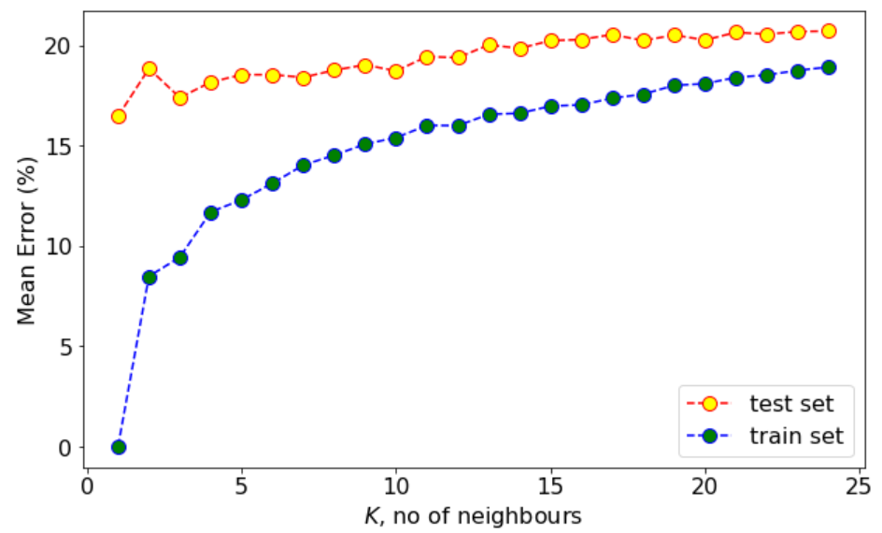
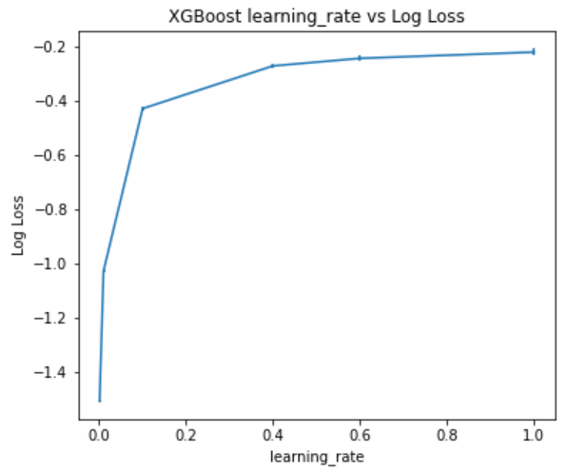
ML Approach
Algorithms
Random Forest
XGBoost
Decision Tree
KNN, k=1
AdaBoost
Bagging
SVM
Multiclass Classification problem (# Rating classes = 5)
Data Normalization has been performed by min-max scaling on the predictor variables.
Train and test set divided into ratio of 75:25.
Accuracy vs. #tress in RF
Error vs. #neighbors in KNN
Loss vs. lr in XGBoost

Slide 18
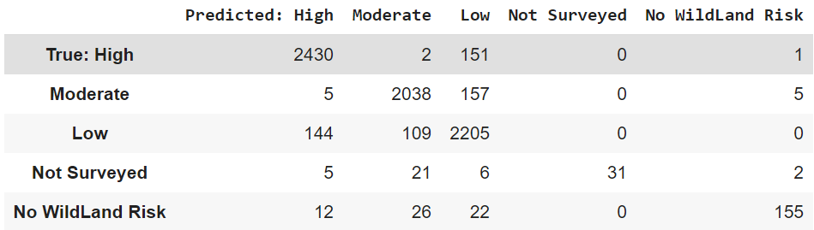
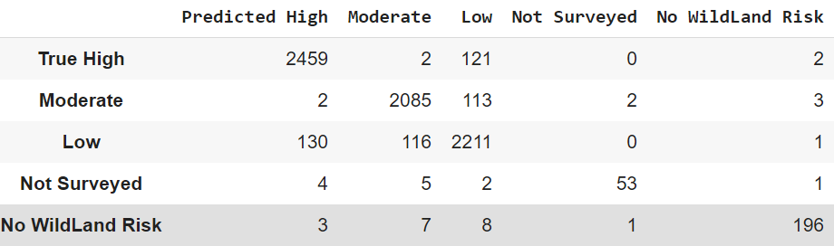
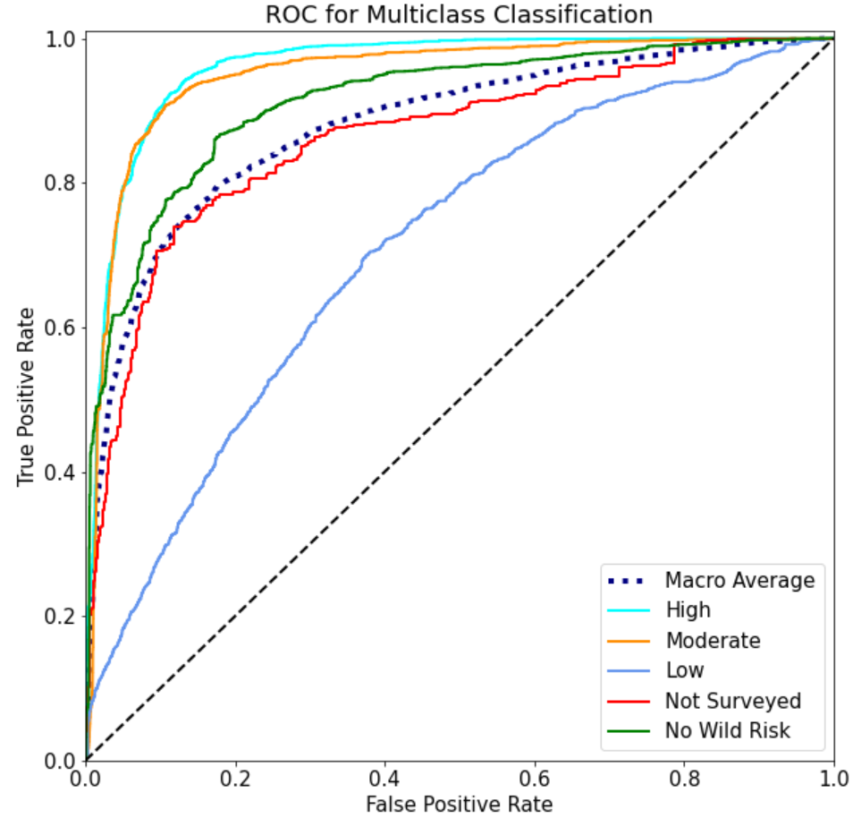
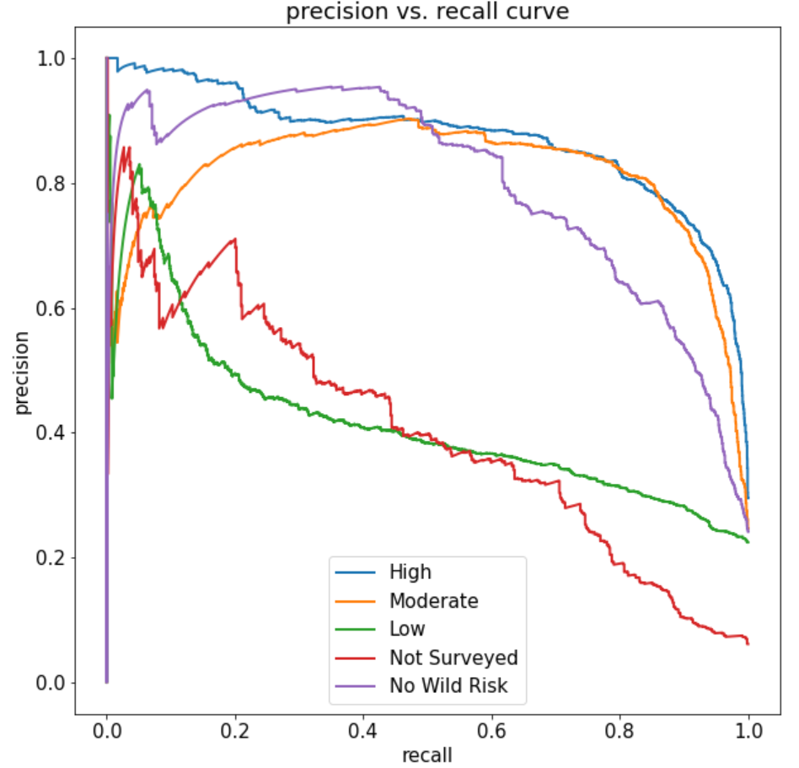
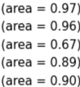
Confusion Matrix from Radial Kernel (SVM)
Confusion Matrix from XGBoost
ROC-AUC and Precision vs. Recall Curve from Linear SVM Classifier for Multiclass Classification

Slide 19

Evaluation Table
Algorithms |  | Accuracy Matrices in %
 |  | Train Set |  |  |  | Test Set
 |  | Accuracy | Precision | Recall | F1 Score | Accuracy | Precision | Recall | F1 Score
Random Forest |  | 98 | 100 | 99 | 99 | 92 | 92 | 93 | 93
XGBoost |  | 100 | 100 | 100 | 100 | 93 | 95 | 95 | 95
Decision Tree |  | 96 | 98 | 98 | 98 | 87 | 91 | 91 | 91
KNN, k=1 |  | 100 | 100 | 100 | 100 | 84 | 88 | 88 | 88
AdaBoost |  | 100 | 100 | 100 | 100 | 91 | 95 | 95 | 95
Bagging |  | 98 | 100 | 99 | 99 | 91 | 94 | 94 | 94
S V M | Linear | 80 | 83 | 91 | 87 | 87 | 90 | 93 | 91
 | Radial | 93 | 95 | 97 | 96 | 91 | 94 | 94 | 94
 | Poly.,3 | 92 | 94 | 95 | 95 | 90 | 94 | 94 | 94
 | Sigmoid | 29 | 40 | 34 | 37 | 26 | 26 | 42 | 32
However, there is no hard and fast rule as to which kernel performs best in every scenario.
It is all about testing all the kernels and selecting the one with the best results on your test dataset.

Slide 20
Conclusion
Ensemble methods like random Forest and XGBoost are performing well in predicting ‘Rating’ variable against Wild Fire hazards!
Sigmoid kernel from SVM is not performing in a desirable manner.
Suitable ML algorithms would be depending on dataset. No Hands-on rule!!

